Slide 1


LLM Reading Group:
Codex
Presented by
Bassel Al Omari

Slide 2
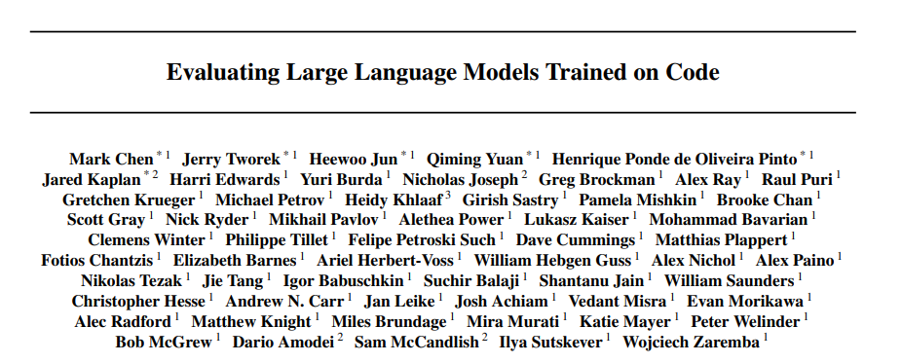
Link to the paper

Slide 3




Slide 4

Context
GPT Models
Autoregressive Language Models
Large Foundation Models
Trained on diverse datasets
Notes:
GPT Models
General and unspecialized
Trained on vast amounts of text data from different fields

Slide 5



Dataset
Training Data
54 Million GitHub Repositories
159 GB of Python
Trained and Tested with Competitive Programming Problems and Interview Questions
Notes:
GPT Models
General and unspecialized
Trained on vast amounts of text data from different fields

Slide 6
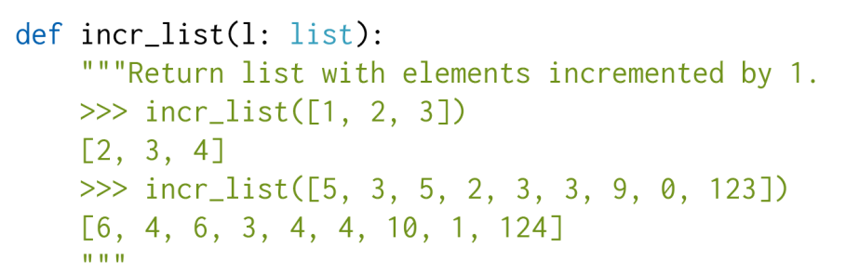
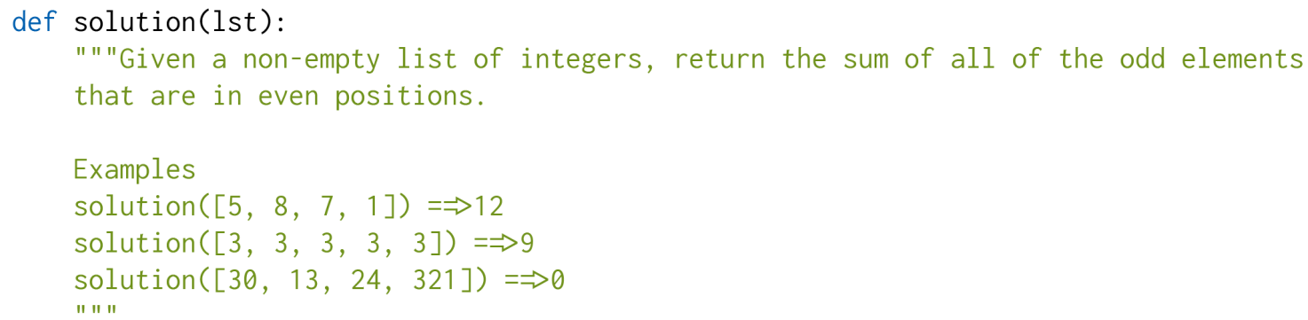
Training
Prompt Examples

Slide 7
Experiments and Evaluations
Codex output were evaluated through unit testing from
Hand crafted questions
Competitive Programming + Interview Questions
Program Function Traces
For security purposes all code was run using gVisor
Pass@k evaluation is used, where k samples are produced and we evaluate what fraction pass unit tests

Slide 8
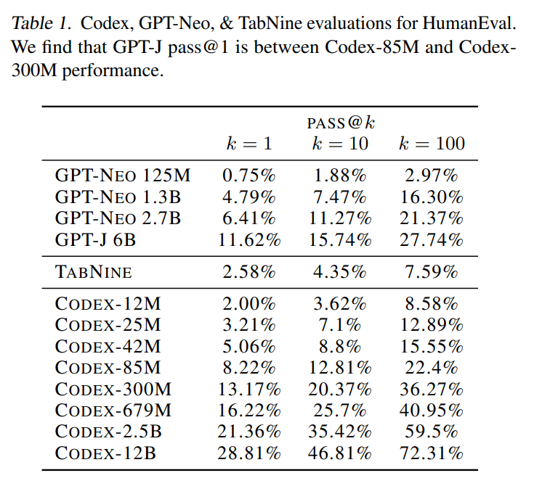
Results
As Codex was allowed to generate more samples performance became better
The largest model reaches 72.31% for Pass@100
Equivalent GPT models only reach up to 27.74% on the same test bench

Slide 9
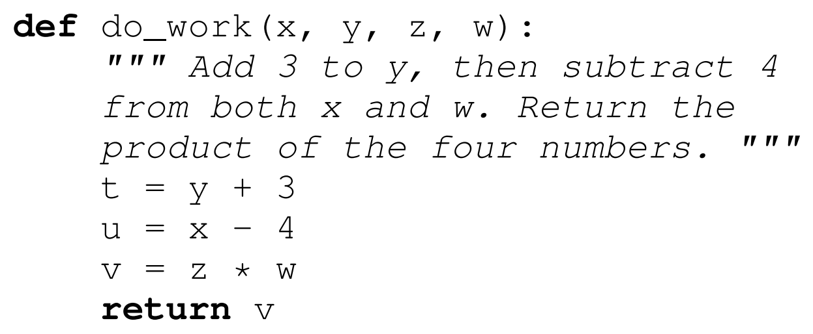
Limitations
Not Sample Efficient (Needs a lot of training data)
Binding operations to variables

Slide 10

Hazards
Code appears superficially correct but has subtle inaccuracies
Misused to generate malicious code
Fairuse lawsuits regarding data used to train Codex + GitHub Copilot (article link)

Slide 11
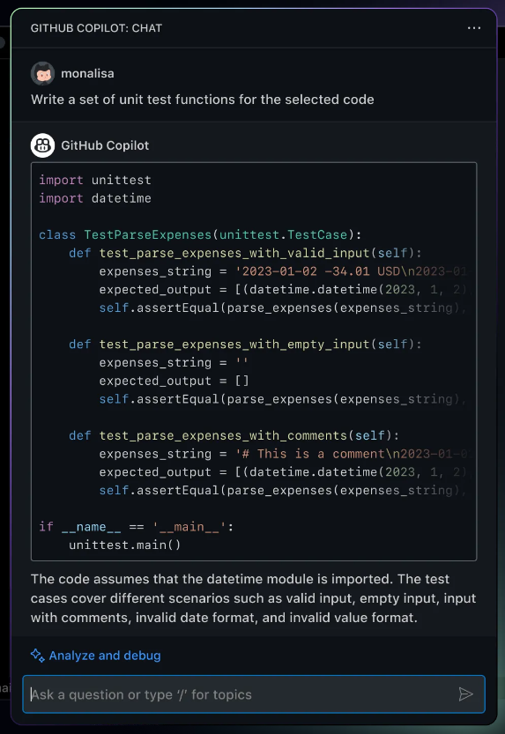
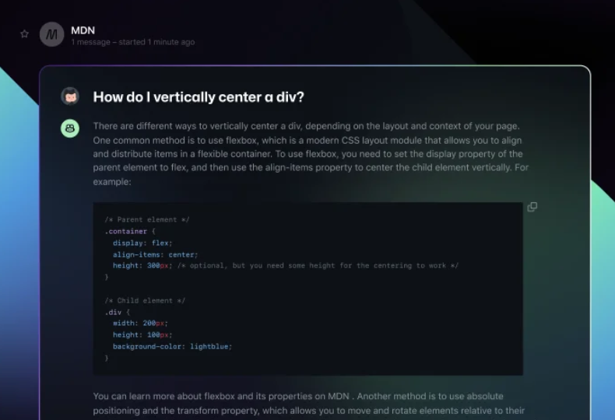
Look Ahead
Notes:
GPT Models
General and unspecialized
Trained on vast amounts of text data from different fields

